Slide 1

Intro to Hardware Programming
Eric Menze
Content and files available online at https://github.com/Ehryk/Talks/

Slide 2
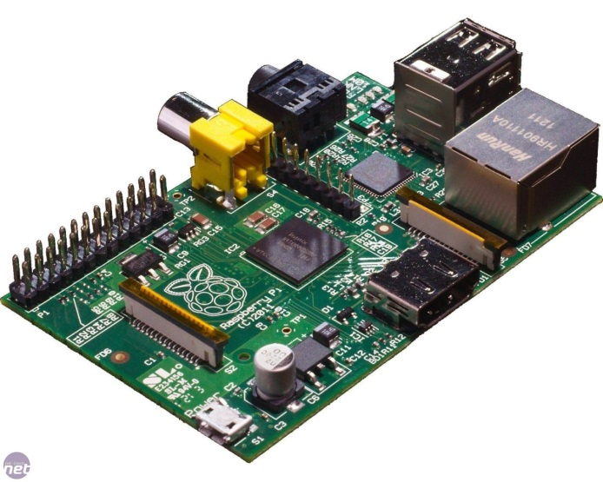
Why Bother?
Too often, our code is far abstracted from us on servers somewhere…
…which sits atop a stack like Java or .NET, abstracting the OS…
…which sits atop an OS like Windows or Linux, that abstracts the drivers…
…which forms a HAL (Hardware Abstraction Layer) that makes sure the OS doesn’t get much direct access…
…which then makes its way to the hardware, if there’s no hypervisor or VM adding more layers in between…
Bother because it’s fun!

Slide 3
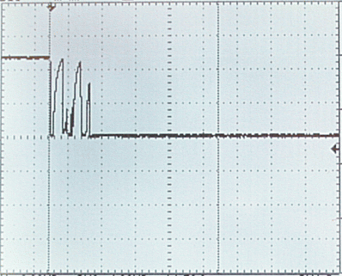
Switch Debouncing and other Oddities
Sometimes our intuitions break down on the extreme scales of measurements; it’s hard to wrap our brains around astronomical time, quantum physics, and black holes.
Modern electronics use time units smaller than we’re used to, so be aware of certain side effects. Even the arduino’s tiny, outdated processor completes a clock cycle in 0.0000625s (0.0625 milliseconds or 625 nanoseconds)
It takes time for current (electron wave propagation) to travel down wire, it’s about 71% the speed of light in copper. This means it only moves about 9 inches per nanosecond, which is why components are moving closer together on motherboards – with a 4 GHz processor, electricity can only move about 2" per clock cycle.
When we push a switch, we interpret the result to be near instantaneous – it’s not, and it’s a common
problem – ever had a remote
that changed two channels at
once?
“Bounce”
Button Pushed

Slide 4
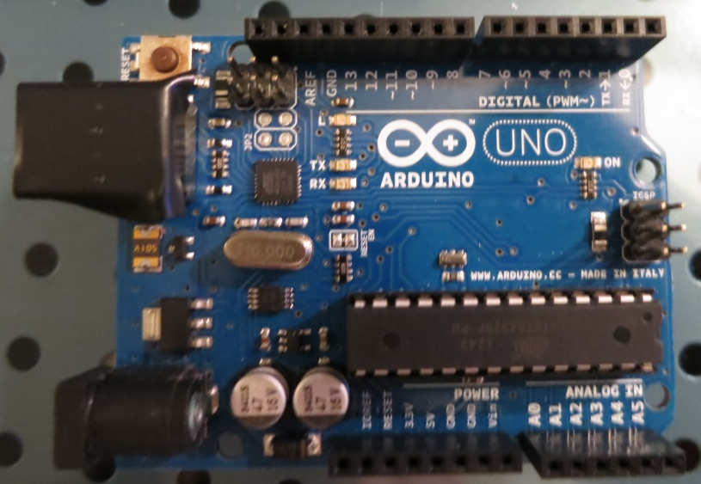
Where do I start?
One of the best tools to start with hardware programming are Arduinos.
Directly interact with hardware at a low level
Large community of code libraries and shields to help learn
Write in a easy to use Java-ish language ‘Wiring’
Hooks to your computer via USB for programming from the Arduino IDE, in addition to manual flashing via USB-TTL programmers for more advanced use
Useful from the beginner (learning) all the way to a professional engineer (prototyping)
Cost: about $35

Slide 5
What makes something an Arduino?
“Arduino is an open-source electronics prototyping platform based on flexible, easy-to-use hardware and software. It's intended for artists, designers, hobbyists and anyone interested in creating interactive objects or environments.”
Being an open design, many things can be considered ‘Arduinos’
Website: http://www.arduino.cc/
Various shapes and sizes: http://arduino.cc/en/Main/Products
General Use: Arduino Uno, Duemilanove (“2009”), Leonardo
Small size constraints: Arduino Nano, Micro, Mini
Networking: Arduino Ethernet, Sparkcore
Cheaper: Diavolino (requires USB-TTL programmer)
Lots of IO: Arduino Due, Mega ADK, Mega 2560
Wearable: Lilypad

Slide 6
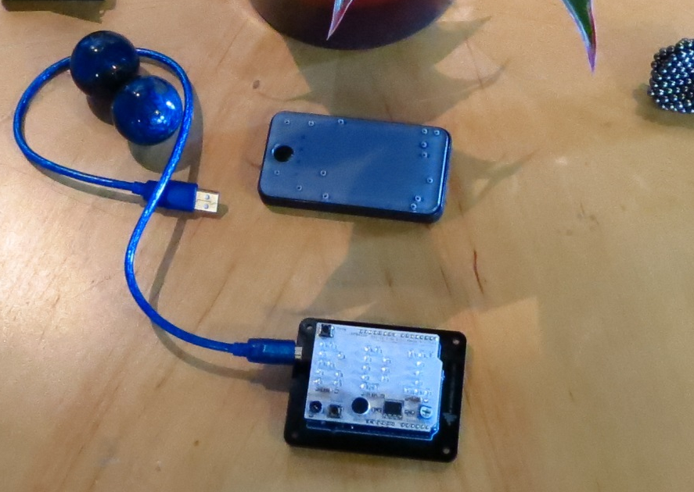
RDI ‘NameShield’
Being passed around Anchorage is a custom shield along with an Arduino Uno, and a portable Li-Ion USB battery pack. I designed it from scratch in an open source program called Fritzing, had it printed in Germany and shipped for about $40/each, and soldered the components together in my ‘secret laboratory’ / desk.
The code is open source on my Github account, as is the schematic and PCB layout: https://github.com/Ehryk/NameShield
It’s meant to be reprogrammed. Don’t be shy.
There’s…. ALMOST no way to fry it.
Cycle through the Modes, adjust the brightness, and ignore the microphone / sensitivity (the amplifier circuit is not working as intended, so the sound level meter feature will have to wait for v1.2)

Slide 7

Arduino Uno Breakdown – Processor
The brains of the operation: Atmel AT Mega 328P-PU
Your code lives here. 16 MHz clock cycle (stable up to 20 MHz), 32 KB flash memory (program space), 2 KB SRAM for variables, 1KB EEPROM for persistent storage. 6 Analog Input pins, 14 digital I/O pins.
Theoretically, this one chip is all you would need to run your code (though you’ll need to provide a stable power source and it and a clock signal, usually via a crystal or oscillator). Current price: $2.49 + Free Shipping on eBay.
The chip is socketed so that when/if you blow it up (happens more than I’d like to admit, usually by applying more than +5V to the Analog Inputs) you can just pop in a new chip.

Slide 8

Arduino Uno Breakdown – USB Interface
Serial Interface: Atmel AT Mega 16u2
This programmable chip translates from USB style logic transmission (+5V, D+, D-, GND) to TTL (+5V, TX, RX, GND). Most chips don’t natively work with USB type logic.
This small Surface Mount chip eliminates the need for separate programmers, and makes Arduinos more accessible to everyone. However, for the advanced users you can flash your own custom code to it (with a programmer via the headers above it) so that it can emulate other USB-devices – mice, joysticks, cameras, etc.

Slide 9
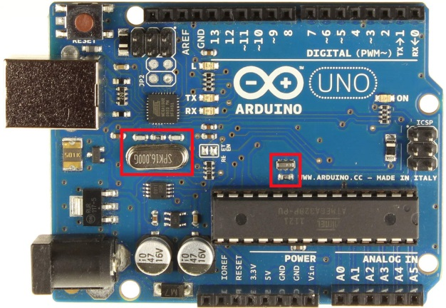
Arduino Uno Breakdown – Clock Signals
Timing is Everything
Near the Serial programmer is a 16 MHz Crystal; a perfectly cut slice of quartz that vibrates at a natural resonant frequency that remains consistent at a large temperature range.
Above the AT Mega 328 is a 16 MHz Oscillator, a Resistor-Capacitor circuit that is cheaper than a crystal, and precise enough for your code (though it is less precise and temperature affects the frequency much more).
The crystal is necessary for fast and stable USB 2.0 operation, and was optional for the processor.

Slide 10
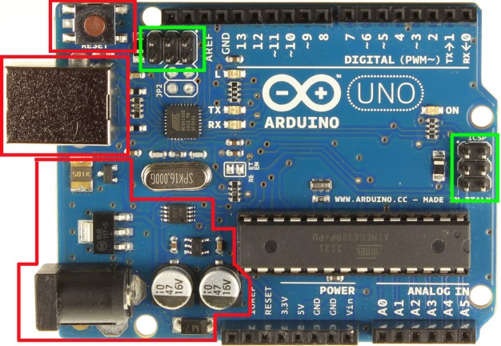
Arduino Uno Breakdown – Connections
Reset Button
USB
Programming
Headers
If you have your own USB to TTL programmer, these provide direct access to the flash memory.
Power Connector,
Regulation and
Stabilization

Slide 11

Arduino Uno Breakdown – LEDs
RX / TX Serial Communication LEDs,
User Programmable LED “L” (I/O Pin 13)
“On”. Sometimes, you just don’t know.
These LEDs allow for the oversight of basic operations, and the LED on pin 13 allows you to at LEAST blink an LED without additional components.

Slide 12
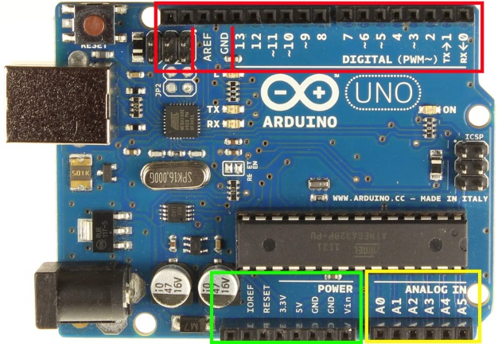
Arduino Uno Breakdown – I/O
Digital I/O – 0 (0V) or 1 (+5V) only
Power I/O
Analog Inputs with 10 bit resolution
(0V = 0, 2.5V = 511, 5V = 1023)
This is where you’ll spend most your time with the Arduino – communicating with stuff! Some pins have special designations for hardware reasons:
Pins 3, 5, 6, 9, 10 and 11 are marked with ~ and capable of Pulse Width Modulation (The brightness of the RDI LEDs are set with this technique)
Pins 0 and 1 are RX and TX, respectively, for Serial communication

Slide 13
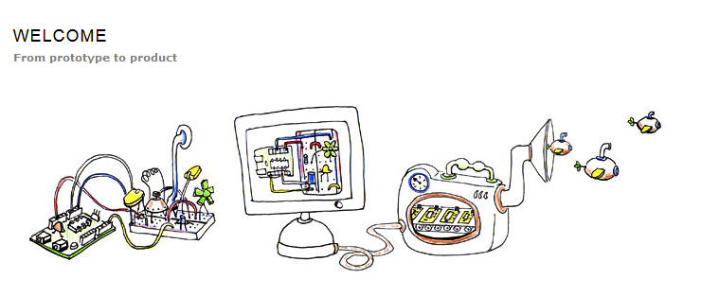
Fritzing!
Go to http://fritzing.org/ and download it yourself – it’s free and open source
“Back in the Day” (the ‘90s), if you wanted printed circuit boards, you either ordered an entire sheet (3 feet by 2 feet) and paid $500 - $1500 for something that may have design flaws, or print the design on a transparency, expose it under the transparency to special light for hours, soak it in caustic chemicals, and rinse off the copper while avoiding toxic fumes.
Now, you can deal with a number of companies that will combine your smaller designs in with others to fill a sheet, break them up and you can divide the cost.

Slide 14
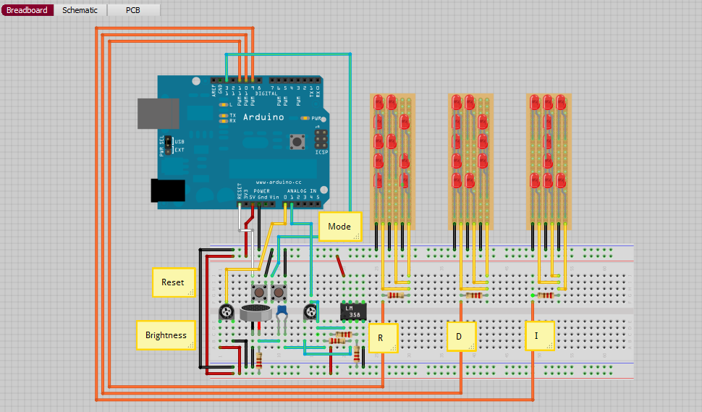
Fritzing – Breadboard View
One of the unique features of Fritzing is their breadboard view – it allows you to place components as you would see them while prototyping.
This is extremely intuitive for beginners.

Slide 15
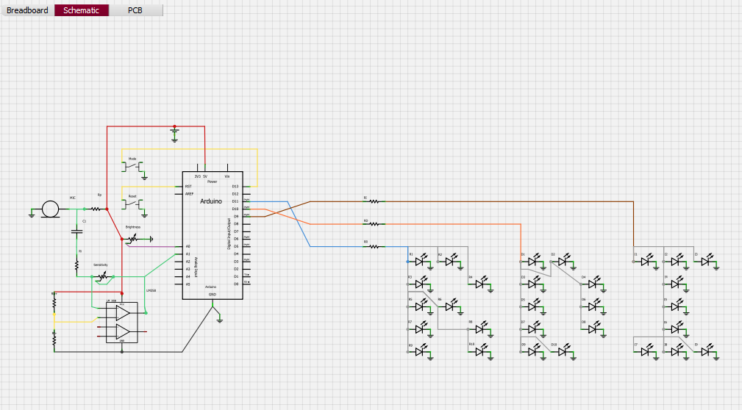
Fritzing – Schematic View
The schematic view allows you to see and edit the project as electrical connections, abstracting the physical dimensions of the components.
The middle is the Arduino, to the right are LEDs, and the left has two potentiometers, two push buttons, a microphone and an OP-Amp.

Slide 16
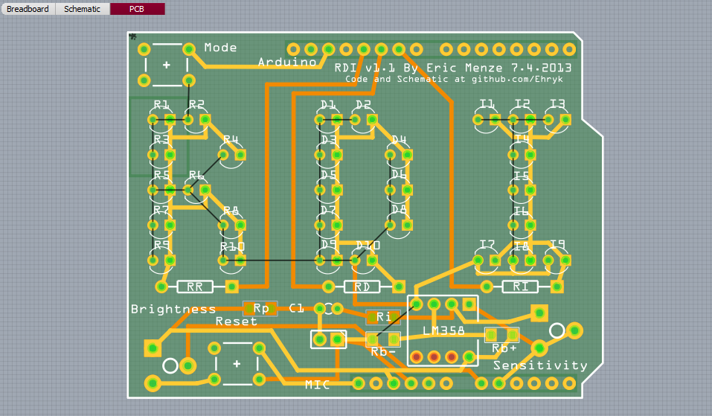
Fritzing – PCB View
PCB View allows you to arrange the components as you would like on a board, verifies everything electrically according to the schematic, and will even route the traces for you (but autorouters are the suck, draw them yourself).
Bright orange = top layer
Dark orange = bottom layer
It also allows the placement of silkscreen lettering (top side only).

Slide 17
Fritzing – Demo
Once you’ve made something with Fritzing, you can export it to generic formats or submit the file for fabrication:
http://fab.fritzing.org/fritzing-fab
Price is per board area in cm² (One Arduino shield is 29 € / $38 + Shipping)
Don’t expect to get it right the first time.

Slide 18
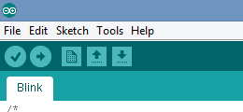
But what about programming?
This is where the Arduino starts to shine. Using the Arduino IDE is intuitive, comes with great example code, and it uploads quickly thanks to the 16 MHz AT Mega 16u2..
Verify – Think ‘Build’. Compiles it to binary,
whines about errors.
Upload – Does just that.
Make sure the Arduino is plugged in.
New, Open, Save

Slide 19
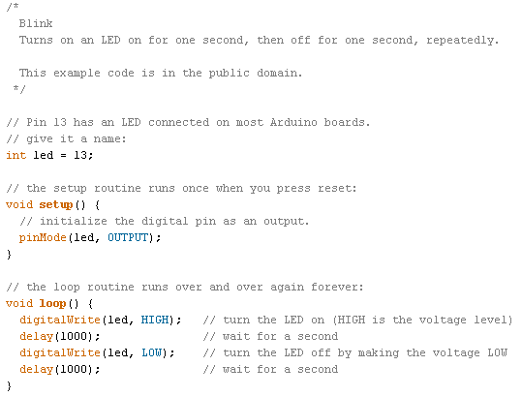
Blink.ino
Define variables and constants
void setup()
Called once, perform initialization tasks
void loop()
Guess what it does?

Slide 20
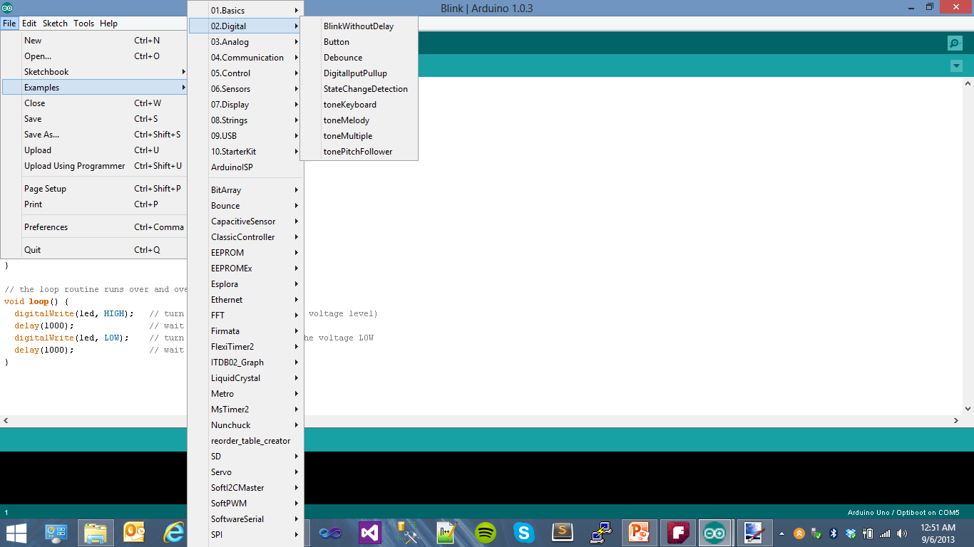
More Example Code
No, really – the sample code provided is EXTREMELY comprehensive.
Start by looking through it for something similar to what you’re trying to accomplish; chances are good something’s in there and working.

Slide 21
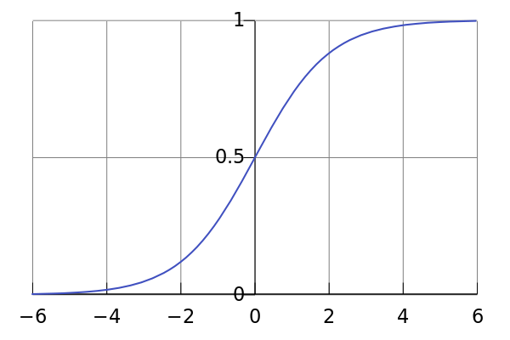
NameShield – Code Demo
Things buried in the source code:
Code.ino
Setup and Initialization: variables, pin references, pinMode()
Timing: delay()
LEDs.ino
Basic I/O: digitalWrite(), digitalRead(), analogRead()
Pulse Width Modulation control: analogWrite()
UserInput.ino
Software Switch Debouncing
A Logistic Function to map a linear potentiometer (Brightness) to apparent brightness to the human eye for PWM LEDs
Modes.ino
Start making your changes here; change target times, make new modes, get creative!

Slide 22

GearDisplay
So how about a more practical use of an Arduino? What can you do with them besides control blinking LEDs?
In a long standing battle of stubborn wills, Arianne finally confessed that perhaps she would be more interested in learning to drive a manual transmission (all my vehicles) IF it told her what gear was currently selected like the P-R-N-D-3-2-1 display of automatics. Not one to back down, I pulled out an Arduino and got to planning….

Slide 23

GearDisplay – Requirement Gathering
Some of the requirements:
Don’t physically touch or restrain the shift lever. I don’t want to lose gears or have my gear-slamming restricted by the device, so linear-pull potentiometers were out
While doing this kind of stuff, the transmission moves noticeably relative to the frame. Pushing contact switches was definitely out, as the shifter can’t be tracked to a precise location.
A solution? Hall Effect Sensors.

Slide 24
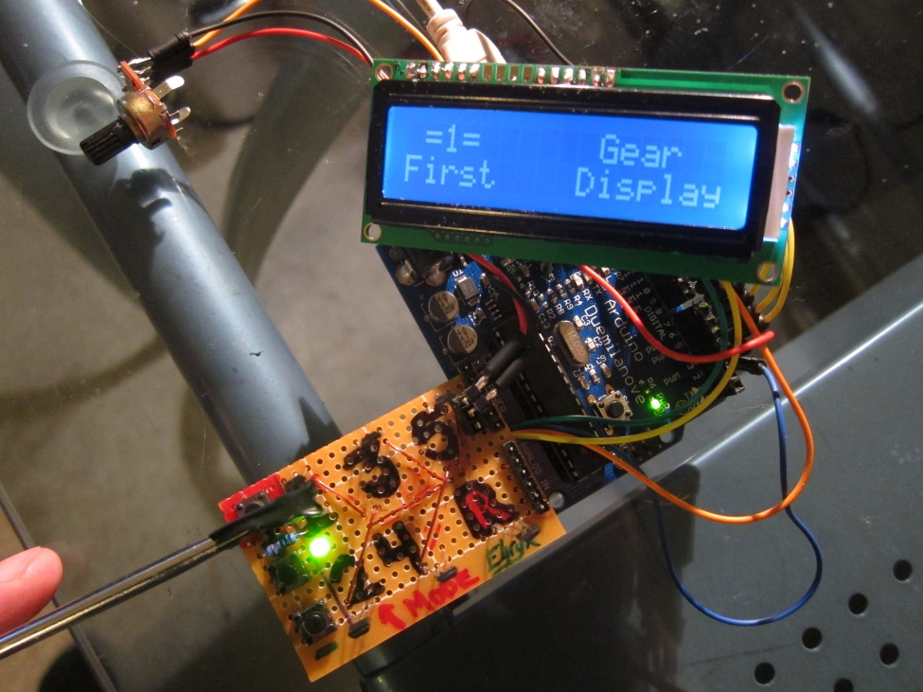
GearDisplay - Prototyping
Hall Effect Sensors can sense the strength of the magnetic field around them, and (some types) convert that to a usable analog signal.
I mocked it up on a prototype board, stuck two neodymium magnets on a screwdriver, did some coding and I was slammin’ through virtual gears within the weekend.
After some conversations with my car-buddies, I added logging elements to track time spent in each gear, number of shifts to each gear, up time, and various other useless-but-neat features.

Slide 25
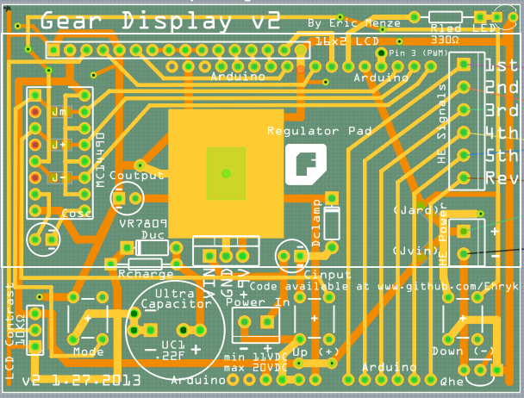
GearDisplay – PCB Design
Feature Creep reared its ugly head: I added an ultracapacitor keep-alive circuit to buy time to save values to the EEPROM before losing power, a MC14490 hardware debounce IC, customizable ‘In Gear’ LED, and ridiculous amounts of nested menu options.
v1 was a standalone board with buttons underneath a 2 row x 16 character LCD display.
v2 (pictured) is fit to some black plastic project cases I found to house it
v3, if brought to fruition, will implement a 240x180 color LCD touchscreen

Slide 26
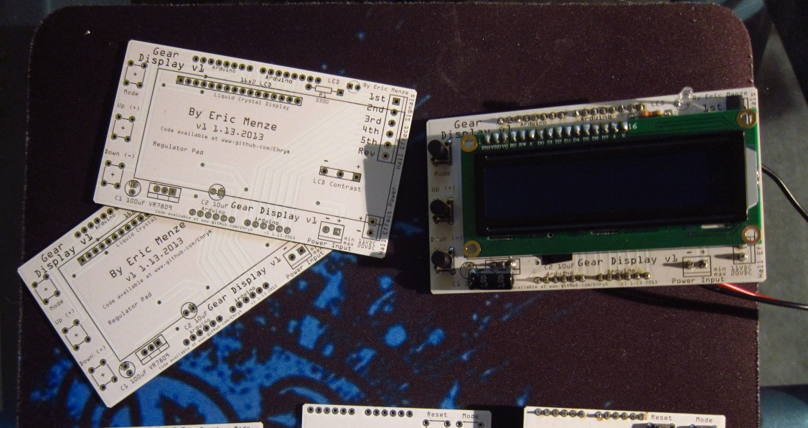
GearDisplay – Soldering it Up
With the circuit board in hand, I cut apart a RGB cable which had (in theory) the number of conductors I needed, 9. In retrospect, the conductors were of a puny 28 AWG and were difficult to work with. CAT6 Ethernet’s 23 AWG solid wires would have been nicer, and will be used in the next one with an external power wire.
Here’s v1, with the buttons on the left and the LCD screen attached. PCBs as shipped sit to the left.
I made a number of design mistakes on this one, including not wiring the LCD backlight and not leaving enough room for the voltage regulator underneath the LCD.

Slide 27
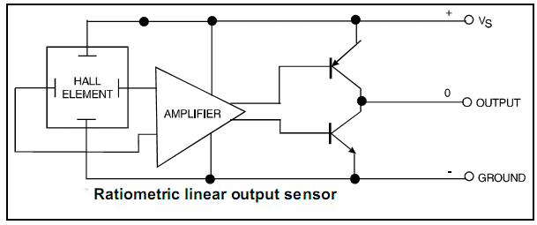
GearDisplay – How it works
Basic Operation: http://www.youtube.com/watch?v=FTQq74HFvWU
Sensor Voltage Display: http://www.youtube.com/watch?v=qHEV87LpvVI
Menu System: http://www.youtube.com/watch?v=9K3rxGJS8n4
Saturation by a South pole: Vcc – 0.7V (~4.3V)
Saturation by a North pole: GND + 0.7V (~0.7V)
Absence of magnetic field: Vcc / 2 (~2.5V)
One hall effect sensor near each gear’s approximate rest position reads the magnetic flux there. Two neodymium magnets straddle the shift lever and provide full saturation at ~2mm. Various selectable algorithms determine which gear is selected based on the 6 analog inputs from the sensors.
The best one (determined heuristically) has been ‘Trim 1 – Mean’ (take the average, discard the furthest outlier (likely a selected gear), take the mean of the remaining 5 as the ‘Baseline’ value and compare each input value to the baseline to see if it is out of the Tolerance value.

Slide 28
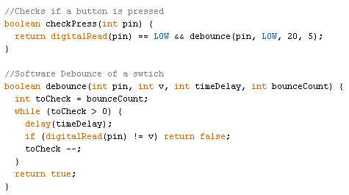
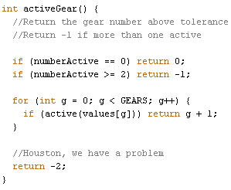
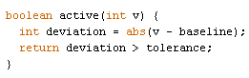
GearDisplay – Code snippets

Slide 29
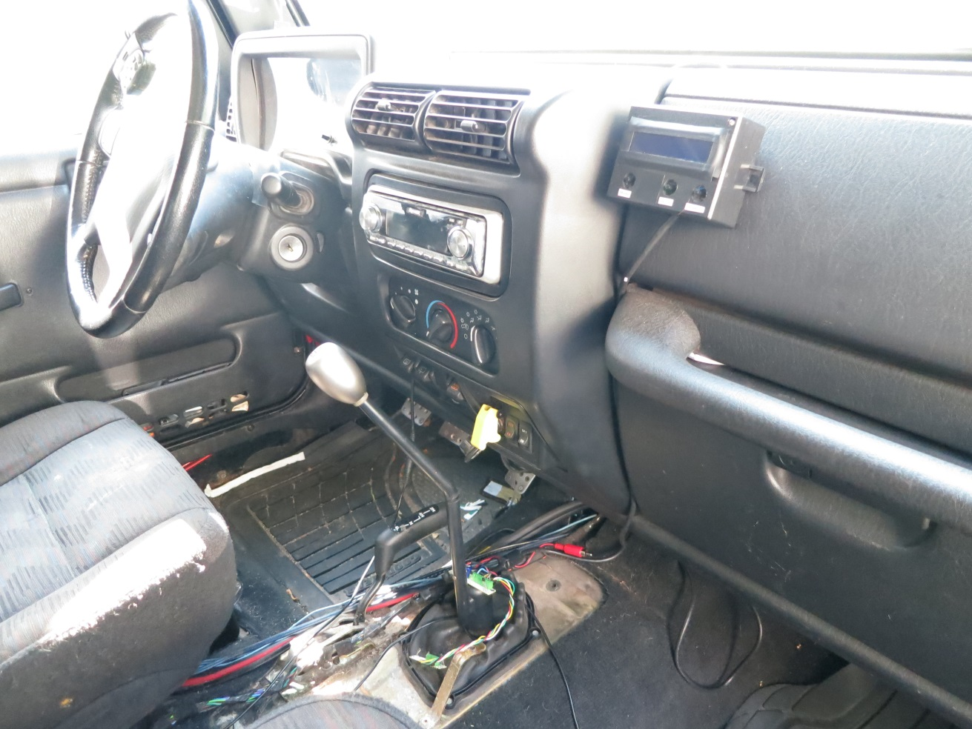
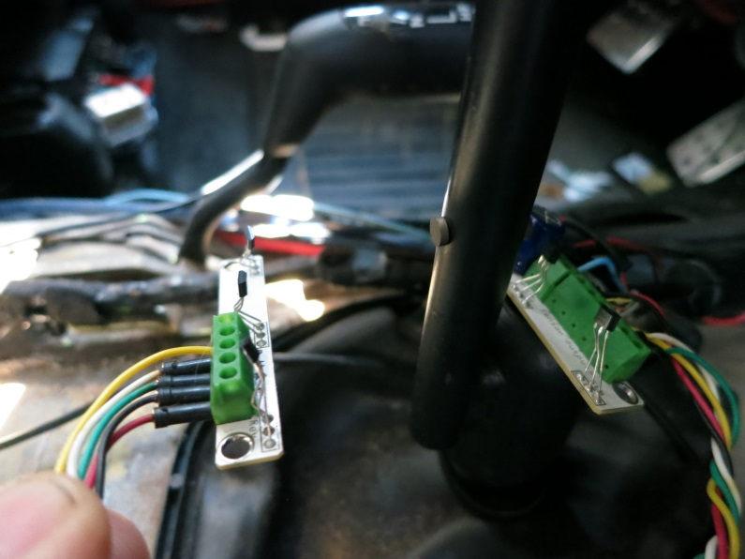
GearDisplay – Installed!
Center console removed,
Unit velcroed to dash.
Still finalizing hall effect board mounting around shifter
Magnets

Slide 30
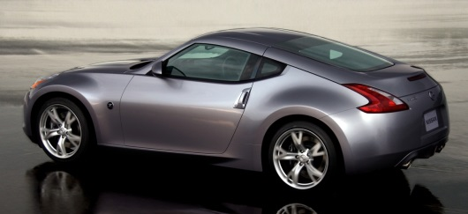


GearDisplay – What’s it good for?
Besides stubborn girlfriends, not much.
Mounting them on the shift lever is a terrible way to go about gear sensing – it’d be easier, more accurate and cheaper just to install them inside the transmission.
Two cars do this already: The Nissan 370Z and the Bugatti Veyron
If accurate enough, it can predict the gear you’re about to shift to
and automatically RPM match
It can track usage statistics and identify gear overuse
With the addition of a clutch sensor, it could track driving habits and identify problem areas
The market is extremely small

Slide 31
Where to get Project Ideas
What can YOU do with an Arduino?
Wirelessly monitor the temperature of your refrigerator, and perhaps tweet when it’s opened? You could catch hungry burglars…
Speaking of burglars, you could become one yourself! With a simple coax connector, an AT Tiny 85 and a crystal, you can unlock 4 million hotel doors across the country. (not responsible if you go to jail, but do politely leave a note that they should upgrade their locks).
Blackhat Paper on the hack: http://demoseen.com/bhpaper.html
Here’s how to build one: http://blog.spiderlabs.com/2012/10/pentesting-hotels-with-pens.html
Here’s a Turn Signal Biking Jacket, the Engineer’s way to automate playing with your dog, lots of instructables, the twenty most unbelievable ones, or perhaps you just want a huge list of awesome Arduino projects.

Slide 32
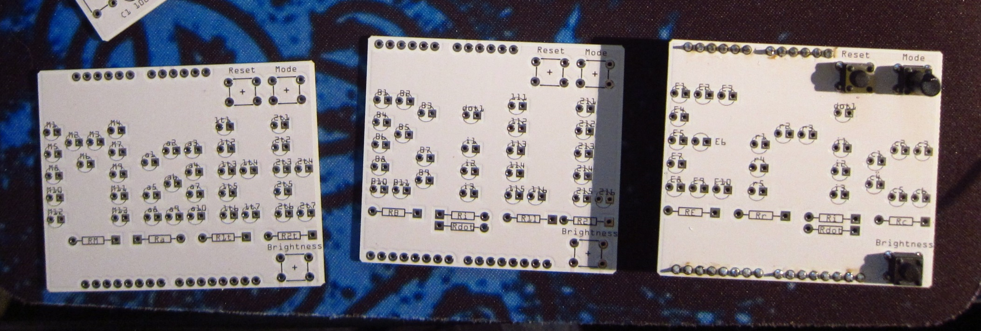
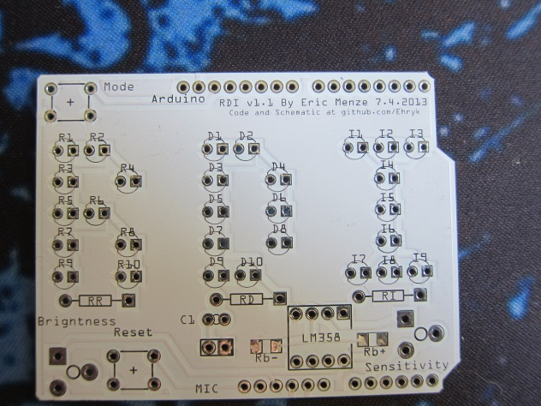
Or make your own NameShields!
Watch on Youtube

